Slide 1

Sentiment Analysis in China Financial Market
Group 7
Chen Zebo
Fu Xueyang
Hu Xueqin
Pan Chuanji
Wang Kun

Slide 2



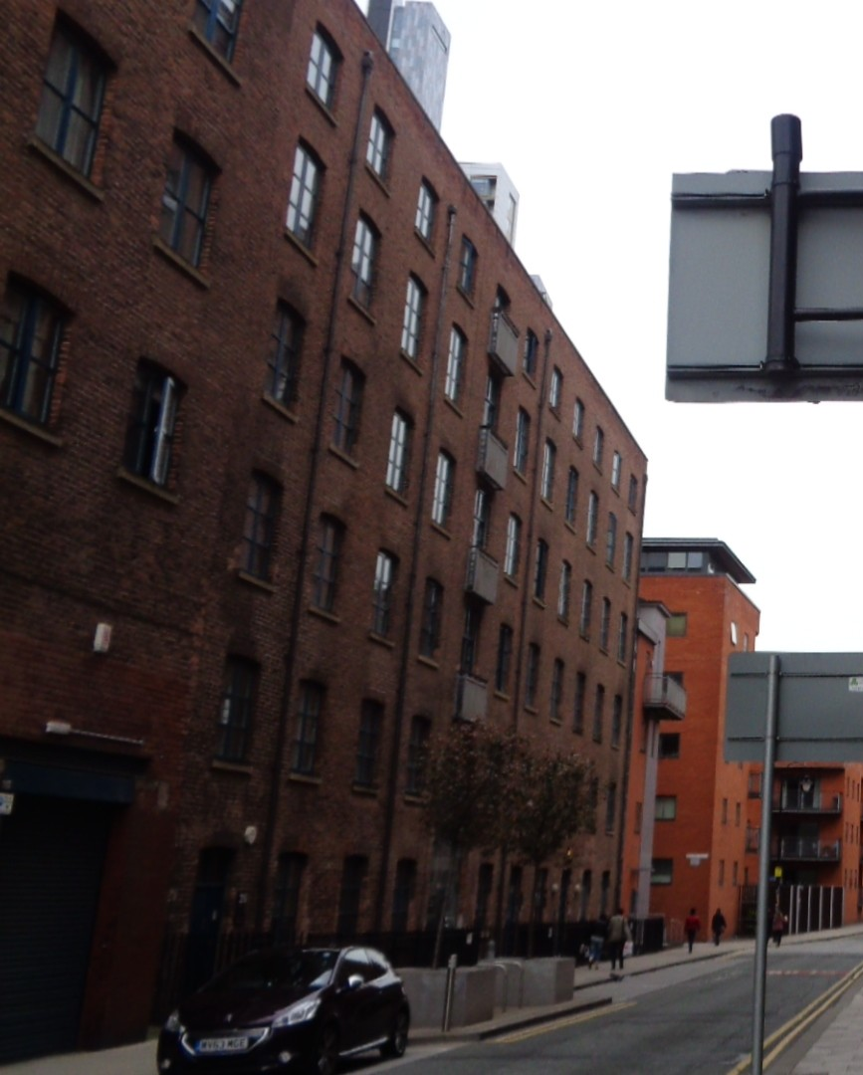



CONTENTS
A. Review
B. Training
C. Analysis
and Result

Slide 3

A. Review
Achievement
Further Plan

Slide 4






A
1
Achievement
By investigating the past year fund performance and related news, we got the word clouds under positive and negative stock as well as simple correlation analysis between sentiment and fund yield.
Selected Industries Sample
Correlation Analysis
 | Petro-Chemical | Medical Care | Military Defense
Positive
14%
Negative

Slide 5
A
2
Further Plan
Since the 14% correlation degree was not satisfying, we found two hidden problems and were going to solve them step by step.
STEP 1
STEP 2
STEP 3
Larger database
Since our initial database only consists of 4,000 pieces of fund-related news, we enlarged our database to all financial market news in sina websites from Jan 2020 to Mar 2021, about 300,000 news.
Do sentiment analysis using new model
After we obtained new sentiment analysis model focused on financial market, we used it to get the sentiment scores for news database and conducted correlation analysis.
Better model for sentiment analysis
Since our initial sentiment analysis was based on Snownlp module, which was designed for e-commerce industry, we retrained this module using Chinese financial news training database to get more accurate estimation.

Slide 6
B. Training
Source Data
Retrain Model
Calculate Accuracy
Sentiment Analysis

Slide 7
B
1
Source Data
The sentiment data set in Snownlp module was not suitable for financial market, therefore we searched for a better training set.
Snownlp sample
Chinese financial training database
Neg
作者对人物的描写也太肤浅，真的很失望。
小熊宝宝我觉得孩子不喜欢，能换别的吗
质量还不错，内容只适合边上厕所便消遣了
很后悔,不怎么样的一本书,千万别买
没有有价值的技巧和方法。。。网上随便查查信息都比书上的全。
The author‘s description of the characters is too superficial. I’m really disappointed.
Baby bear, I don't think kids like it. Can you change it for something else
The quality is not bad, the content is only suitable for the side toilet
I'm sorry. Don't buy a bad book
There are no valuable techniques and methods... It's better to look up information on the Internet than in books.
中国股市存在严重的制度缺陷
让“幕后黑手”和庄家一起赔——从亿安科技案看民事赔偿优先原则
国信天津日评：利空不断强制平仓
证券市场应立即建立民事赔偿机制
There are serious institutional defects in China's stock market
On the principle of giving priority to the compensation of the "black hand" in the civil case
GuoXin Tianjin daily review: bad news constantly forced to close positions
The securities market should establish the civil compensation mechanism immediately
Pos
等待中的房地产板块新股更显活力
贵州房改推动房地产市场快速增长
市场增压 北京逼近好房时代
北京四环路贯通 四方受益不均
王石：万科把握住了房地产全面回暖的机遇
Waiting for new shares in the real estate sector to show more vitality
Guizhou housing reform promotes rapid growth of real estate market
Beijing is approaching the era of good housing
The Fourth Ring Road in Beijing is connected, and the benefits are uneven
Wang Shi: Vanke seizes the opportunity of comprehensive recovery of real estate
我是一名幼儿园老师，这套书是我买来送人的，那个对象——五岁的小女孩喜欢得不得了，天天晚上都会在床上看啊看啊，她妈妈都说我自己看得眼花了，我们宝宝却是爱得不得了，阅读的兴趣非常浓，一天不看都不舒服的。
I'm a kindergarten teacher. I bought this set of books as a gift. The object, a five-year-old girl, is very fond of it. Every night she would read it in bed. Her mother said that I was dazzled by it, but our baby was very fond of it. She was very interested in reading, and it was uncomfortable not to read it all day.

Slide 8
B
1
Source Data
We downloaded a Chinese financial training database, consisting about 7m data and got 200,000 final training data by sampling.
^{Row Database}
We downloaded a training set of Chinese financial news headlines.
Date: from 2001 to 2020
Size: 7,000,000
Pos/Neg: 50/50
^{Introduction}
^{Sampling Database}
Because there were too many data in the raw database and the convergence speed was very slow, it may take more than 10 hours if the whole training set was thrown in. Hence, we randomly take 200,000 pieces of data.
Date: from 2001 to 2020
Size: 200,000
Pos/Neg: 50/50
Training/Test: 2/1
^{Introduction}

Slide 9
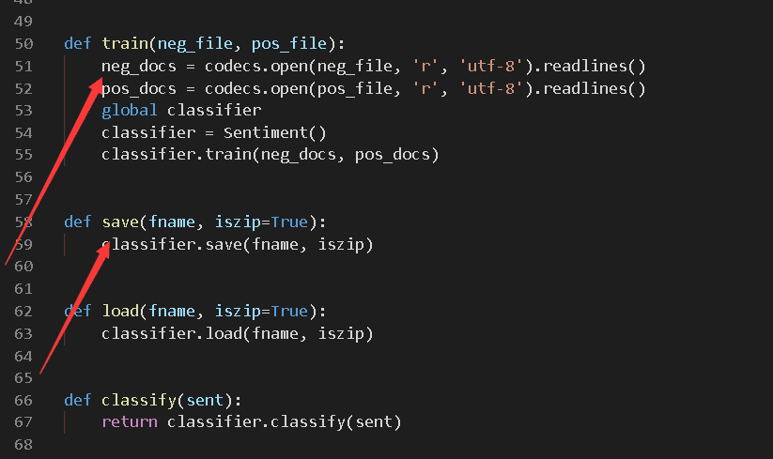
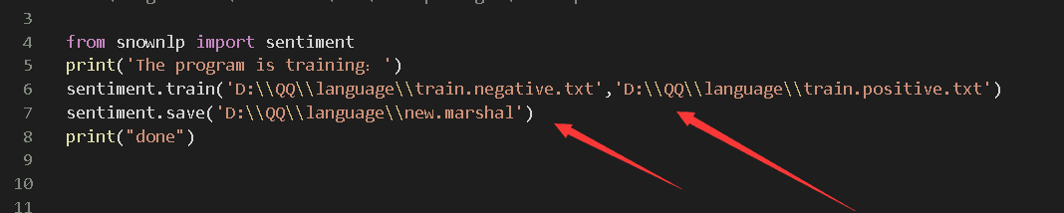
B
2
Retrain Model
We used the training set to retrain Snownlp module to make it more suitable for financial market.
Find the Function interface （init doc.)
Train() is the training function
Save() is the saving function
External call function for training
When calling train() function, the train.positive.txt and train.negative.txt are replaced with a new dataset.
New marshal Model is saved for training.
STEP 1
STEP 2

Slide 10
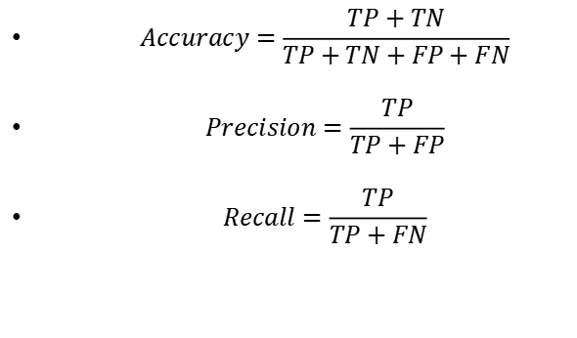
B
3
Calculate Accuracy
After training, we used the testing set to test the accuracy of our new method and the the accuracy rate was around 80%.
Important Terminals to
understand accuracy
 | Relevant | Non-Relevant
Retrieved | Ture Positive(TP) | False Positive(FP)
Not-retrieved | False Negative(FN) | True Negative(TN)
Accuracy: The proportion of correct prediction (positive and negative) in the total.
Precision: The proportion of correctly predicted positive is the proportion of all predicted positive.
Recall.: The proportion of correctly predicted positive to all actual positive.
$$Accuracy=\frac{TP+TN}{TP+TN+FP+FN}$$
$$Precision=\frac{TP}{TP+FP}$$
$$Recall=\frac{TP}{TP+FN}$$

Slide 11
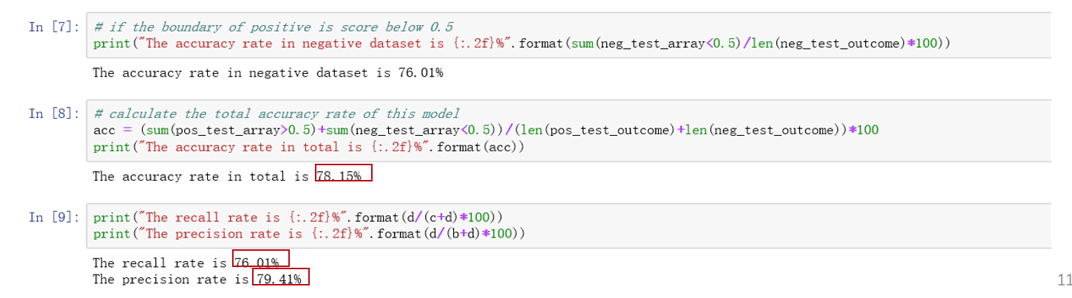
B
3
Calculate Accuracy
After training, we used the testing set to test the accuracy of our new method and the the accuracy rate was around 80%.
^{Result}
Accuracy:78.15%
Recall: 76.01%
Precision:79.41%

Slide 12
B
4
Sentiment Analysis
After training, we used the retrained module to calculate the news dataset and get each day’s sentiment scores and its standard deviation.
Average sentiment scores(MA5)
Std of sentiment scores per day

Slide 13
C. Analysis and Result

Slide 14
C
1
Summary of Analysis
A summary of regression analyses and robust tests
Independent Variables
 | Sentiment MA5 | Sentiment Yesterday | Sentiment Volatility Yesterday
Fund Return | Insignificant Robust | Insignificant Robust | Insignificant Robust
Fund Volatility | Significant Robust | Significant Robust | Significant Robust
Stock Return | Insignificant Robust | Insignificant Robust | Insignificant Robust
Stock Volatility | Significant Robust | Significant Robust | Significant Robust
Dependent Variables

Slide 15
C
2
Stock index as a proxy of fund performance
Most of the funds are equity funds, therefore, the fund performance can be represented by the stock index.
Based on the regression analysis, the fund return and volatility are found to have strong correlation with the stock return and volatility, respectively.

Slide 16
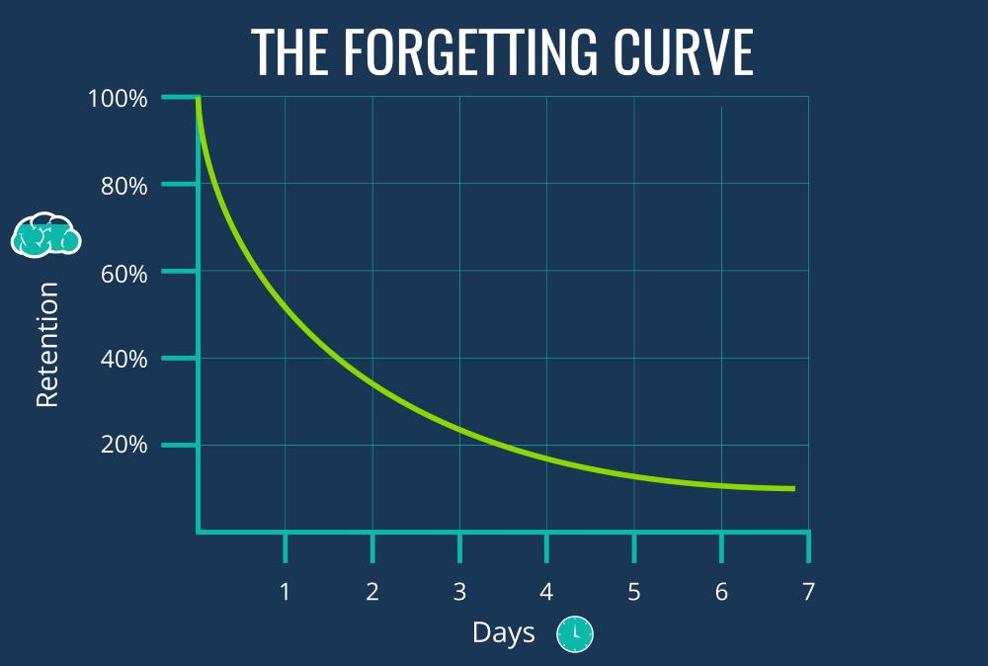
C
3
Regression Analysis I
Sentiments in the past 5 days cause fluctuations in stock and fund market
Why 5 Days?
Based on the Ebbinghaus forgetting curve, after 5 days, people tend to forget 77% of the contents.
Therefore, we believe the effect of news can only sustain for at most 5 days.
More Happiness, More Stable Market
The stock index daily volatility is found to be negatively correlated with the average sentiment scores in the past 5 days at 99% significance level.
There is a clear trend that more positive news will lead to a more stable stock market.

Slide 17



C
4
Regression Analysis II
Interesting Finding: High Fluctuations in the sentiments will not be translated into high fluctuations in the stock market.
Sentiments Fluctuations
Normally speaking, if there are very different sentiments co-existing during one day, there should be much buy and sell activities.
Those activities could potentially increase the volatility in the market
$$≠$$
However, Not In China
We have performed regression analysis between stock volatility and yesterday’s sentiment volatilities.
There is a subtle trend that the higher sentiment volatilities will somehow stabilize the stock market.

Slide 18


